Slide 1
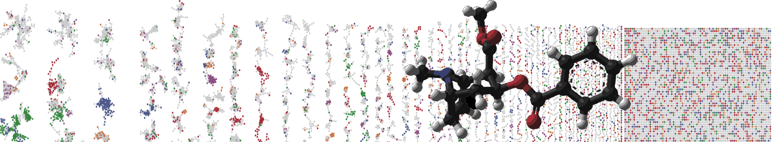


Metabolomics Spectrum Resolver
HANDS ON
ENTER AUTHORS HERE
University of California - San Diego

Slide 2
Objectives and Data
https://metabolomics-usi.ucsd.edu
Visualize/Customize Spectra Using Resolver
Explore ways to get the identifier

Slide 3
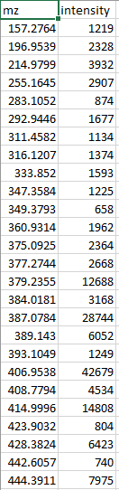
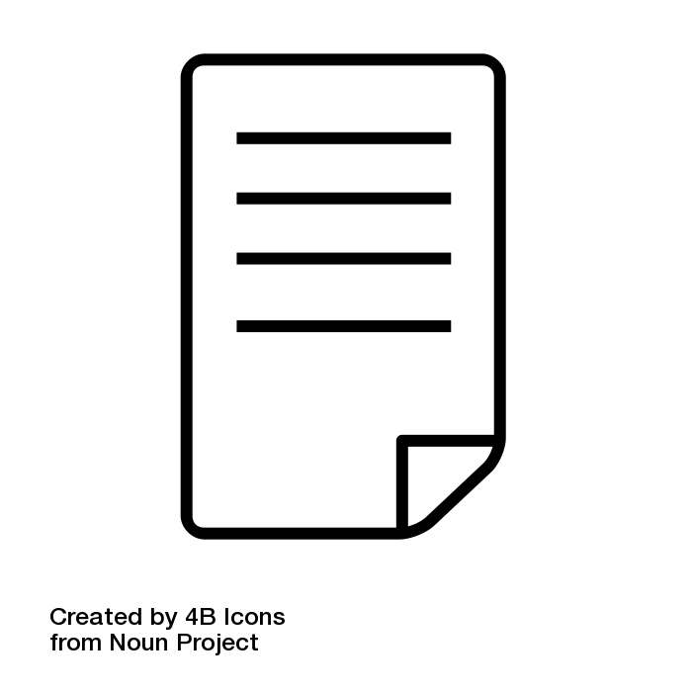
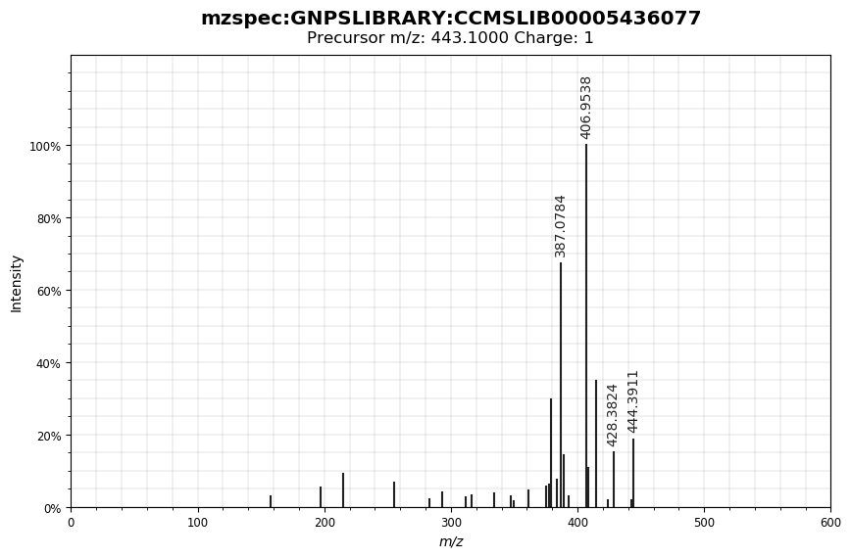
Visualizing Spectra for Publication
Full LC/MS Mass Spec File
Extract Spectrum
Visualize Spectrum

Slide 4


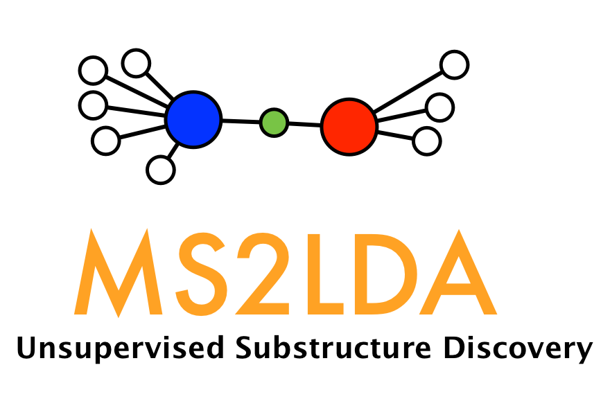
Visualizing Spectra for Publication
Extract Spectrum
Visualize Spectrum

Slide 5
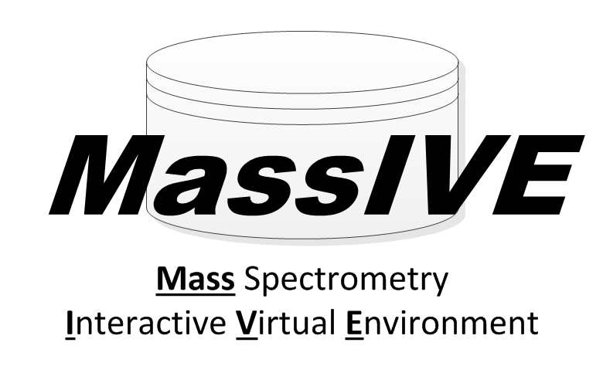
Visualizing Spectra for Publication
Extract Spectrum
JSON
CSV
Accessible via/API
Visualize Spectrum
Vector
Resize
Customize
Embeddable

Slide 6
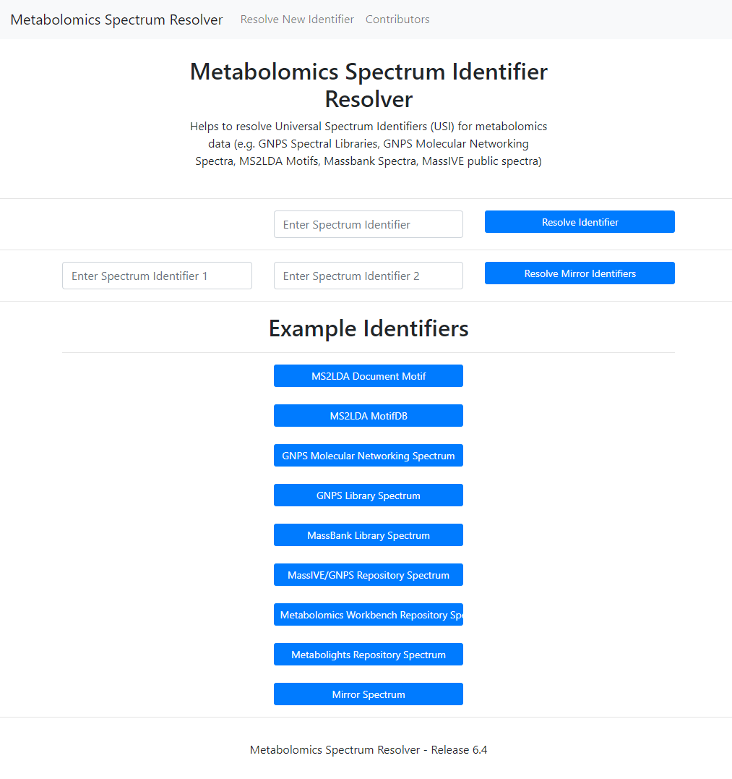
Visualization with Metabolomics Spectrum Resolver
https://metabolomics-usi.ucsd.edu

Slide 7
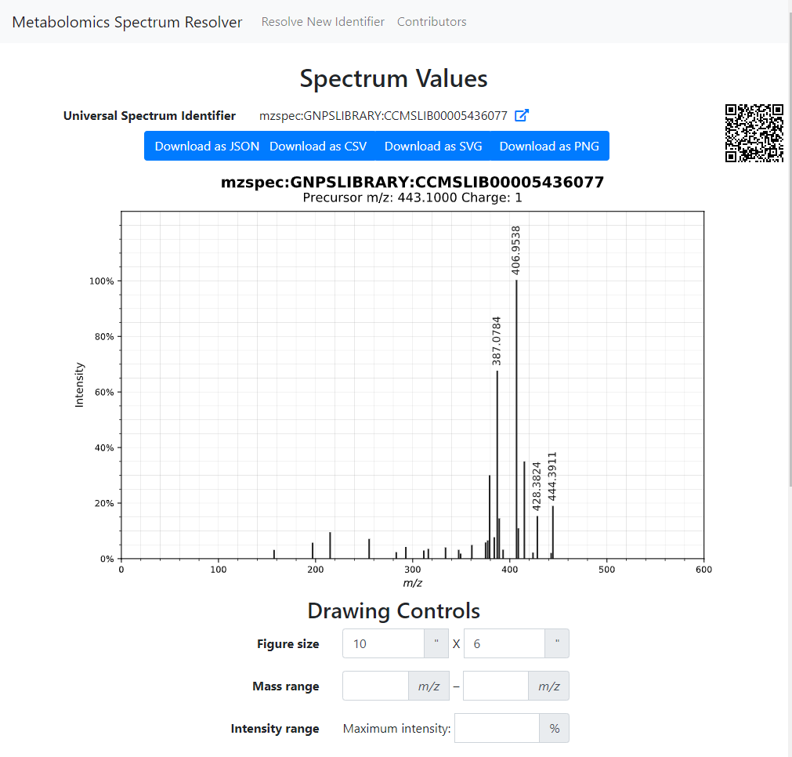
Visualization with Metabolomics Spectrum Resolver
https://metabolomics-usi.ucsd.edu
Download
Various Formats
QR Code
Embed in Poster/Paper
Customize
Visualization

Slide 8
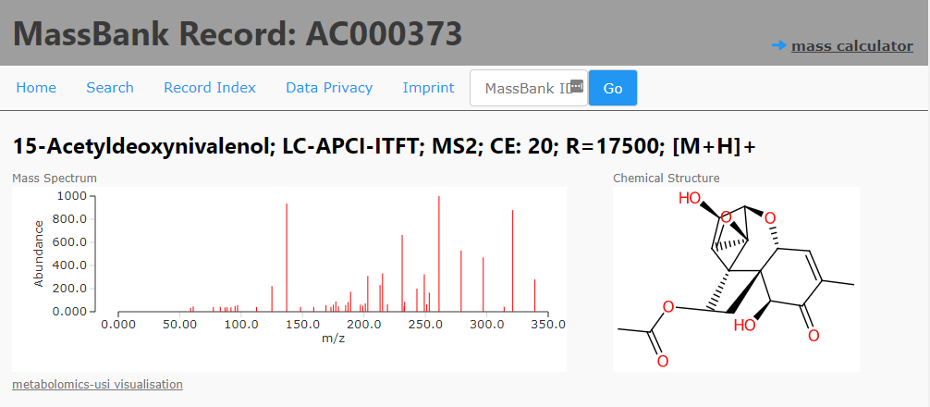
Visualize Directly from MassBank

Slide 9
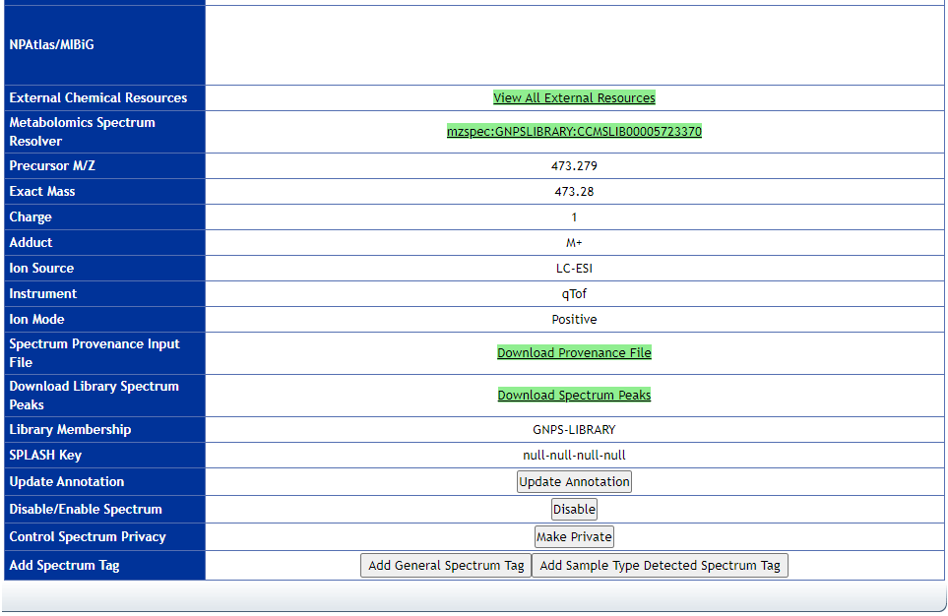
Visualize Directly from GNPS Libraries
Example Library Page

Slide 10
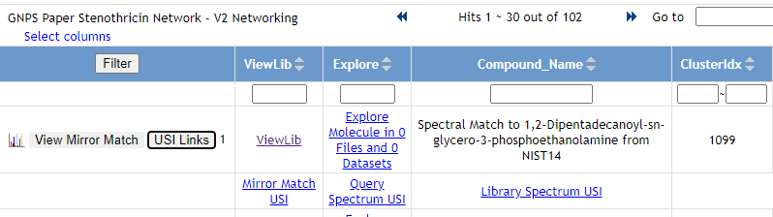
Visualize Directly from GNPS Molecular Networking
Example Networking Job

Slide 11
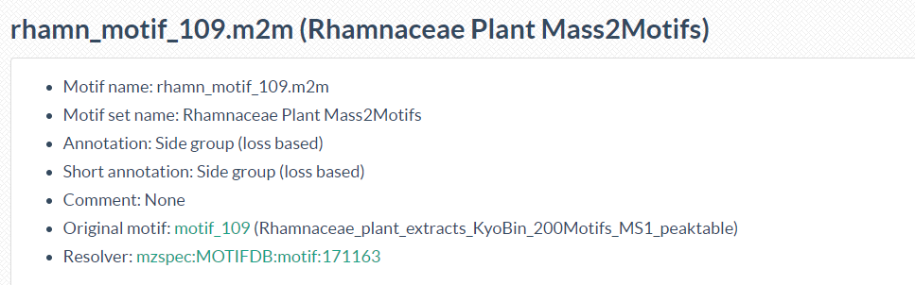
Visualize Directly from MS2LDA MOTIFDB

Slide 12
Questions, Problems or Bugs?
Documentation: https://ccms-ucsd.github.io/GNPSDocumentation/
Forum: https://groups.google.com/forum/#!forum/molecular_networking_bug_reports
PRESENTER NAMES AND EMAILS HERE

